Slide 1
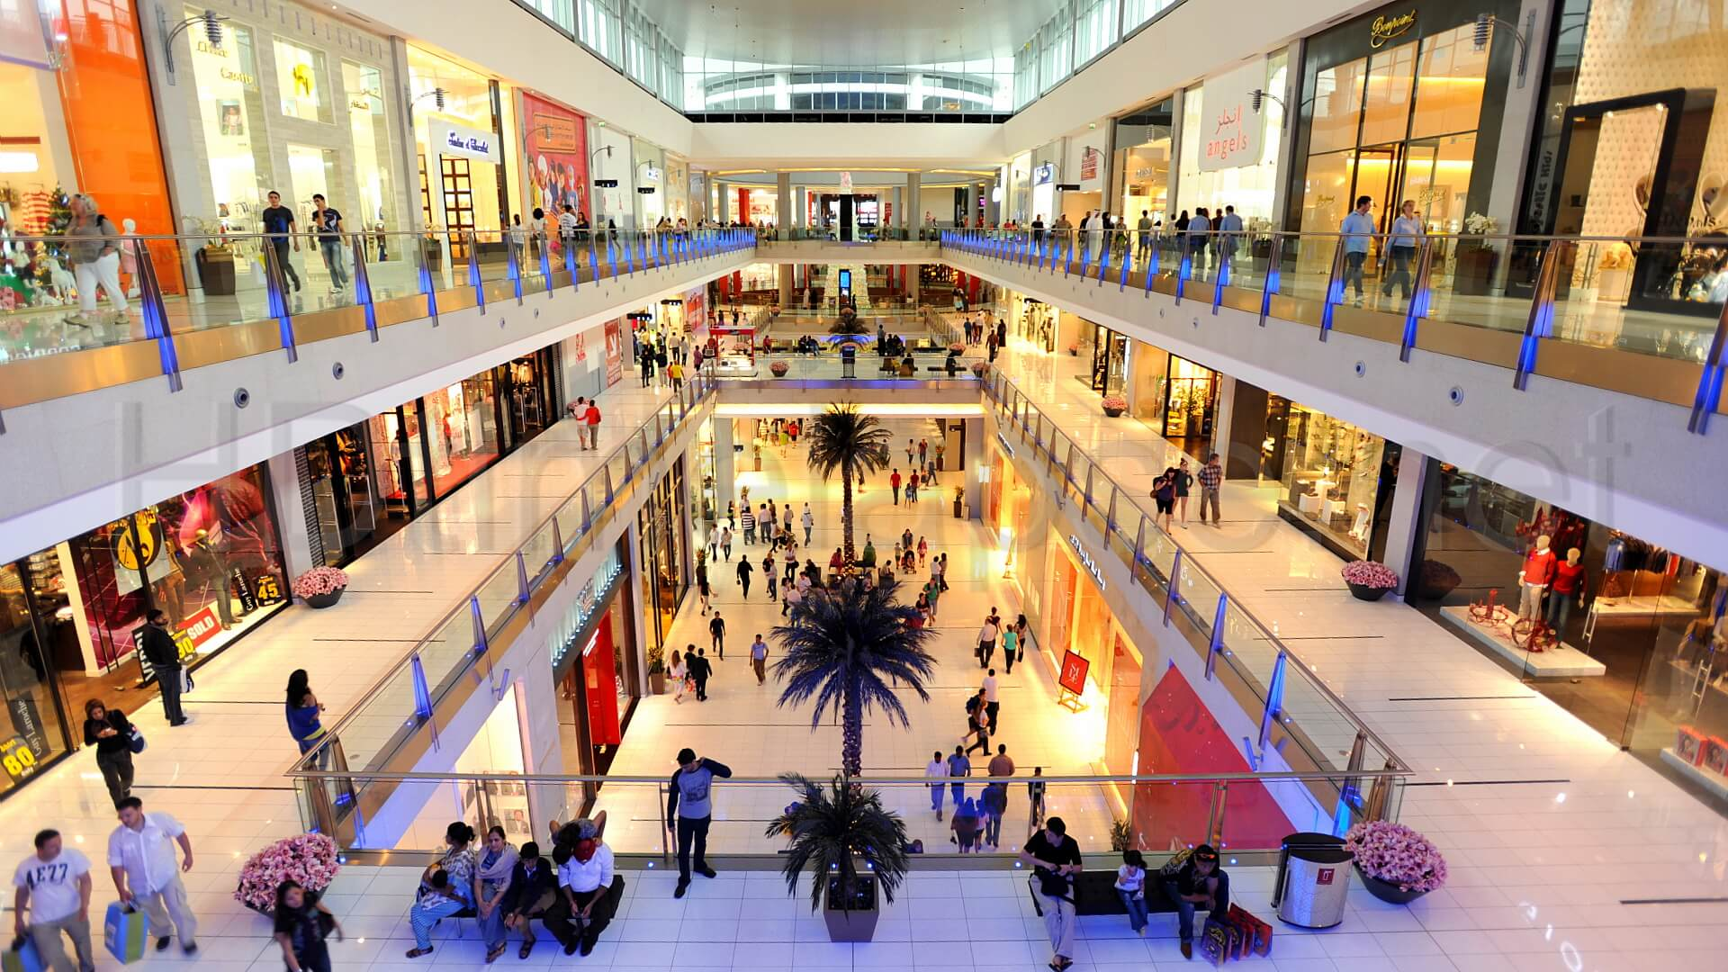
Mall Customer Segmentation
Presented by : Lavkush kumar

Slide 2
We will understand how malls work on customer segmentation and increase their profit.
To achieve this task machine learning is being applied by many stores already. It is amazing to realize the fact that how machine learning can aid in such ambitions.
The shopping complexes make use of their customers’ data and develop ML models to target the right ones. This not only increases sales but also makes the complexes task much easier.
Being a Mall owner, One always worry about how to increase their sells, on which parameter they should focus and which age group they should target.
There is a problem to give Offers and Deals to the specific customers. How they should target to the customers who are frequent to mall, having high income and recognizing their proper choice. By knowing above problems answers owner of the mall can increase their sells and serve better to the customer.
We have datasets of a Mall and we are going to predict how to increase its sells. Here we are using Unsupervised Machine Learning concept. We have some information about customers like Gender, Age, Annual Income and Spending Score. Based on these parameters we are going to apply Machine Learning Algorithm (Unsupervised Machine Learning), will do visualization and Analysis of data. After that we will find clusters in the dataset and conclude our prediction.

Slide 3
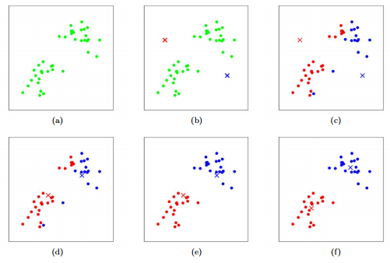
K-Means clustering
Clustering : Clustering is the process of dividing the entire data into groups (also known as clusters) based on the patterns in the data.

Slide 4
The aim of K-Means algorithm is to divide M points in N dimensions into K clusters (assume k centroids) fixed a priori. These centroids should be placed in a wise fashion so that the results are optimal which otherwise can differ if locations of the centroids change. So, they should be placed as far as possible from each other.
Each data point is then taken and associated with the nearest centroid until no data points are pending. This way an early grouping is done and at this point, k new centroids have to be recalculated as these will be the centers of the clusters formed earlier. After having calculated these centroids, the data points are then allocated to the clusters to the nearest centroids. In this iteration, the centroids change their position stepwise until no further modifications have to be done and the location of the centroids remain intact.
So we have 5 steps to follow:
Step 1: Choose the number of clusters k
Step 2: Select k random points from the data as centroids
Step 3: Assign all the points to the closest cluster centroid
Step 4: Recompute the centroids of newly formed clusters
Step 5: Repeat steps 3 and 4

Slide 5
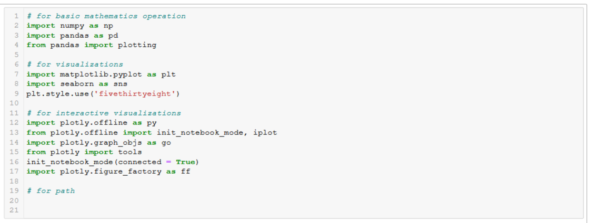
Import all the required library

Slide 6
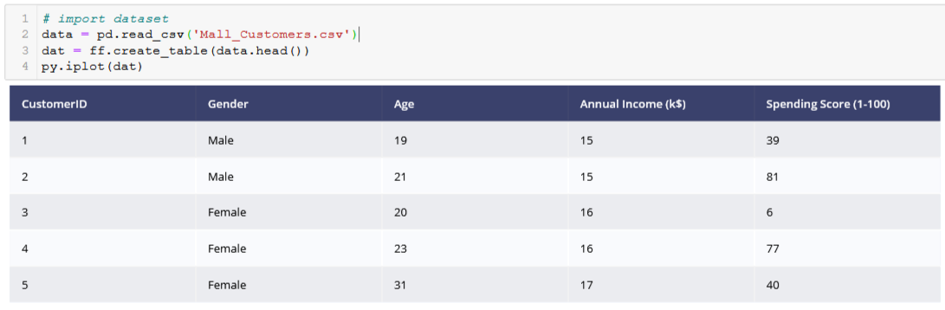
Lets see how our data looks like

Slide 7
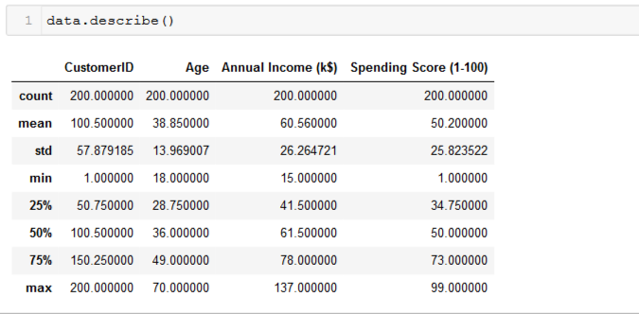
Statistics of dataset

Slide 8
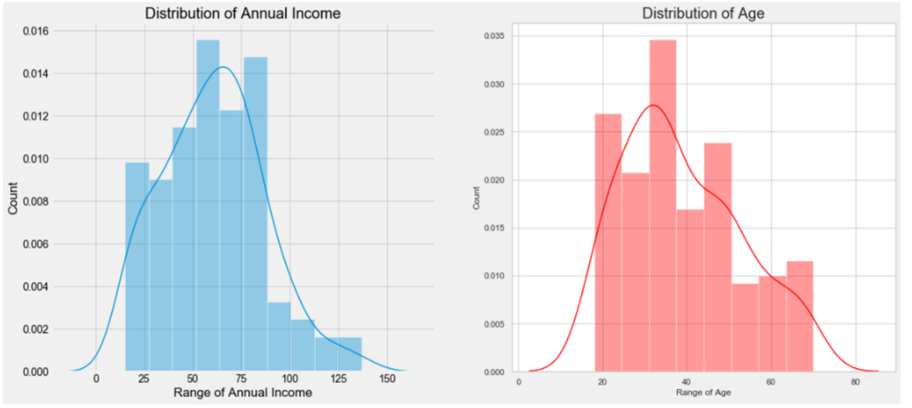
Here, In the above Plots we can see the Distribution pattern of Annual Income and Age, By looking at the plots, we can infer one thing that There are few people who earn more than 100 US Dollars. Most of the people have an earning of around 50-75 US Dollars. Also, we can say that the least Income is around 20 US Dollars. Taking inferences about the Customers. The most regular customers for the Mall has age around 30-35 years of age. Whereas the the senior citizens age group is the least frequent visitor in the Mall. Youngsters are lesser in umber as compared to the Middle aged people.

Slide 9
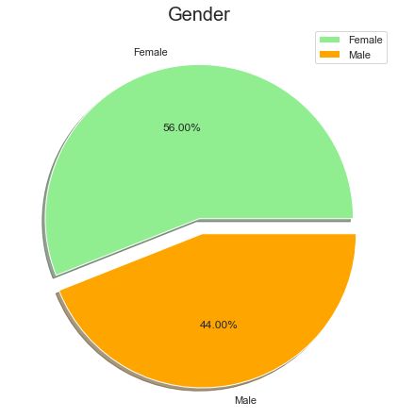
Gender Distribution

Slide 10
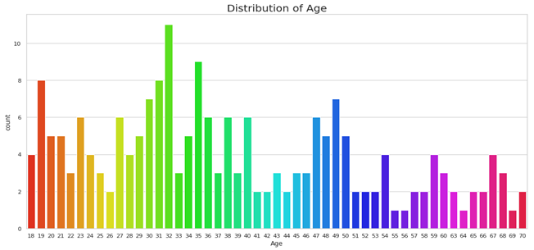
By looking at the above graph-, It can be seen that the Ages from 27 to 39 are very much frequent but there is no clear pattern, we can only find some group wise patterns such as the the older age groups are lesser frequent in comparison. Interesting Fact, There are equal no. of Visitors in the Mall for the Agee 18 and 67. People of Age 55, 56, 69, 64 are very less frequent in the Malls. People at Age 32 are the Most Frequent Visitors in the Mall.

Slide 11
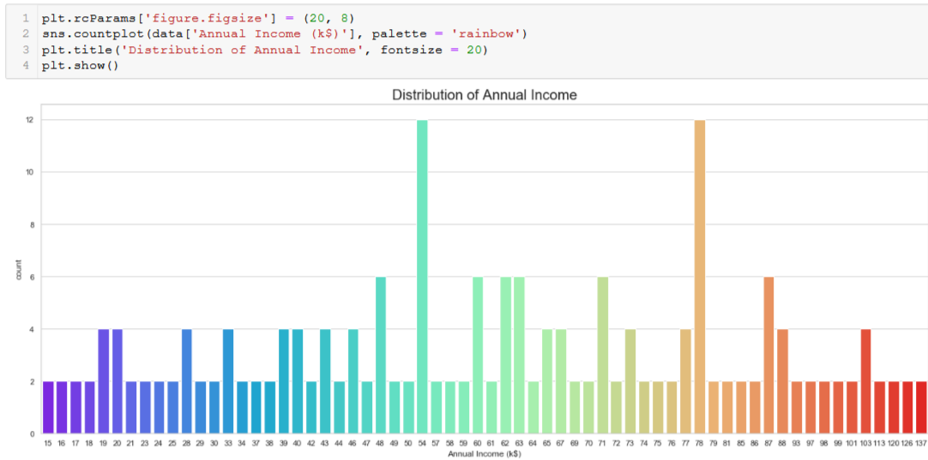
Again, This is also a chart to better explain the Distribution of Each Income level, Interesting there are customers in the mall with a very much comparable frequency with their Annual Income ranging from 15 US Dollars to 137K US Dollars. There are more Customers in the Mall who have their Annual Income as 54k US Dollars or 78 US Dollars.

Slide 12
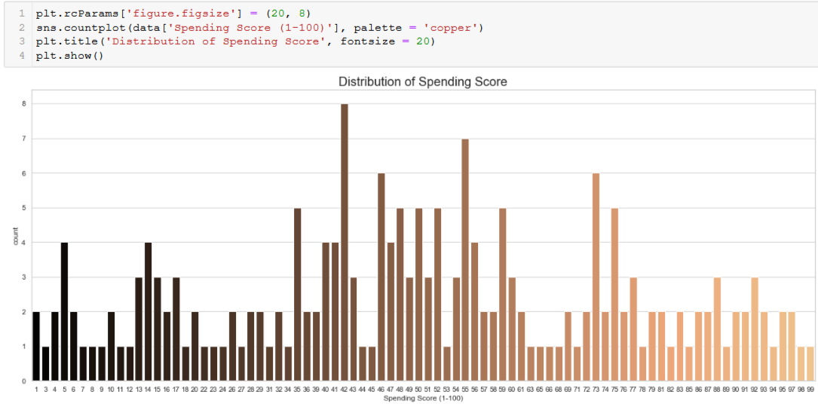
This is the Most Important Chart in the perspective of Mall, as It is very Important to have some intuition and idea about the Spending Score of the Customers Visiting the Mall. On a general level, we may conclude that most of the Customers have their Spending Score in the range of 35-60. Interesting there are customers having 1 spending score also, and 99 Spending score also, Which shows that the mall caters to the variety of Customers with Varying needs and requirements available in the Mall.

Slide 13
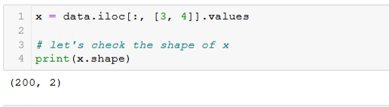
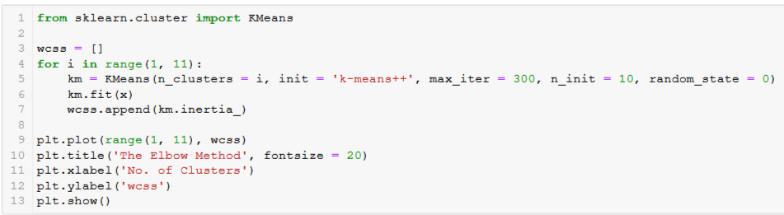
Elbow method to find accurate no of clusters

Slide 14
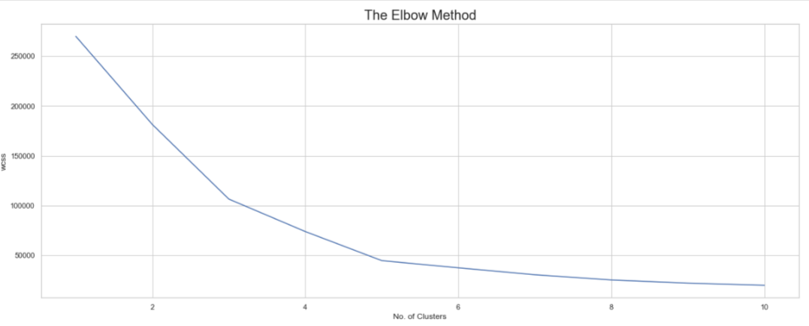
We can see from the curve that at number of cluster = 5 the curve has took the last sharp change after this point the curve has not been changes sharply so we will choose cluster = 5 for our data

Slide 15
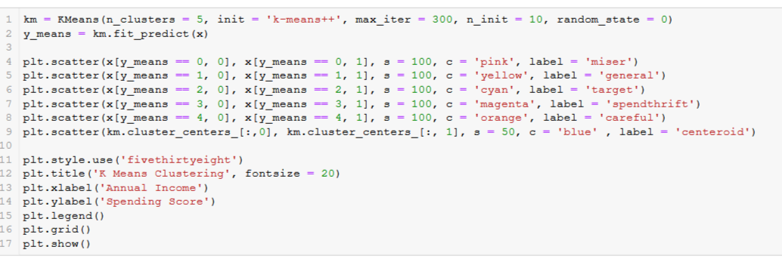
Lets see the clusters in our dataset of annual_income and spending_score

Slide 16
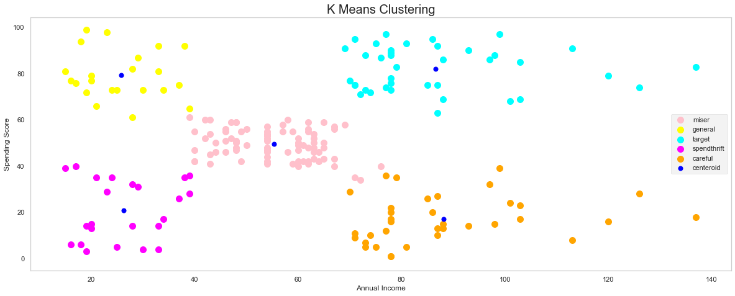
This Clustering Analysis gives us a very clear insight about the different segments of the customers in the Mall. There are clearly Five segments of Customers namely Miser, General, Target, Spendthrift, Careful based on their Annual Income and Spending Score which are reportedly the best factors/attributes to determine the segments of a customer in a Mall.

Slide 17
Now we have implemented k-means clustering and saw the result. This project shows that how clustering is beneficial in grouping up same type of data. We came to know that visualization is a very important role in any project. Elbow curve is very good to find accurate no of clusters for any dataset.
Due to increasing commercialization, consumer data is increasing exponentially. When dealing with this large magnitude of data, organizations need to make use of more efficient clustering algorithms for customer segmentation. This clustering models need to possess the capability to process this enormous data effectively. The computational speed of K-Means clustering algorithm is relatively better as compared to the hierarchical clustering algorithms as the latter require the calculation of the full proximity matrix after each iteration . K-Means clustering gives better performance for a large number of observations while hierarchical clustering has the ability to handle fewer data points.

Slide 18
Thank you

